Slide 1
Integrative Modeling of H₂O₂ Stress Response Network in Escherichia Coli
Chen Liao, Ph.D.
Joao Xavier Lab
Memorial Sloan-Kettering Cancer Center

Slide 2
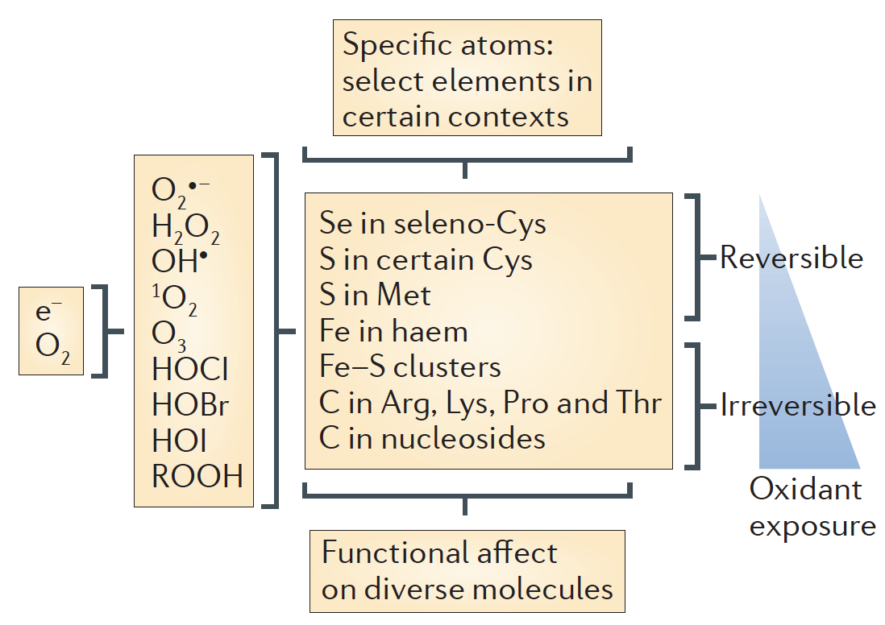
Reactive Oxygen Species (ROS)
Nathan and Cunningham-Bussel. 2013. Nat. Rev. Immunol.
Notes:
During the reduction of oxygen to water, sequential one-electron reductions can produce reactive oxygen intermediates
ROS at low levels tend to react reversibly with a limited number of atoms
At higher levels ROS are likely to react irreversibly with certain iron and carbon atoms

Slide 3
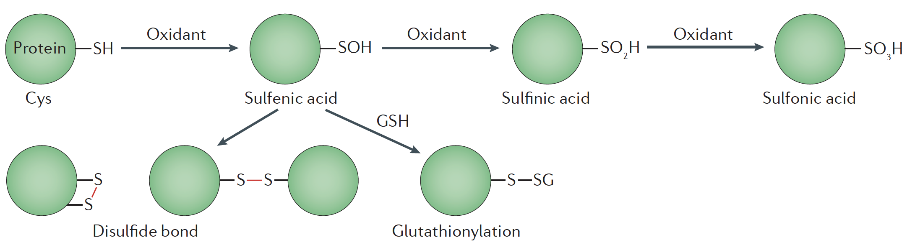
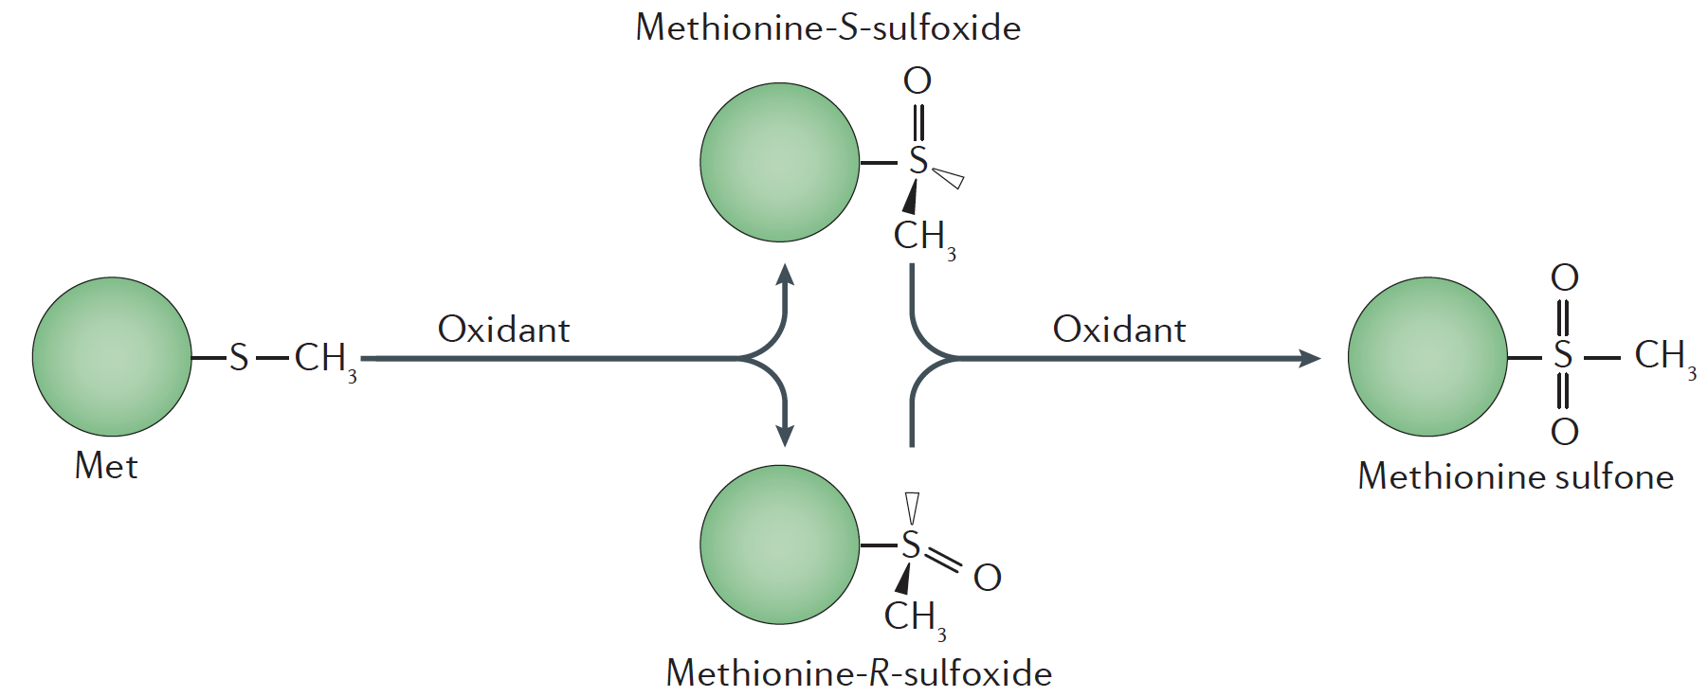
Oxidation of Cysteine and Methionine Residues
Oxidative damage can result in covalent modifications that destabilize and inactivate proteins.
Cysteine:
Methionine:
Ezraty et al. 2017. Nat. Rev. Microbiol.
Notes:
The sulfur-containing amino acids cysteine and methionine are particularly susceptible to reactive oxygen species (ROS).

Slide 4
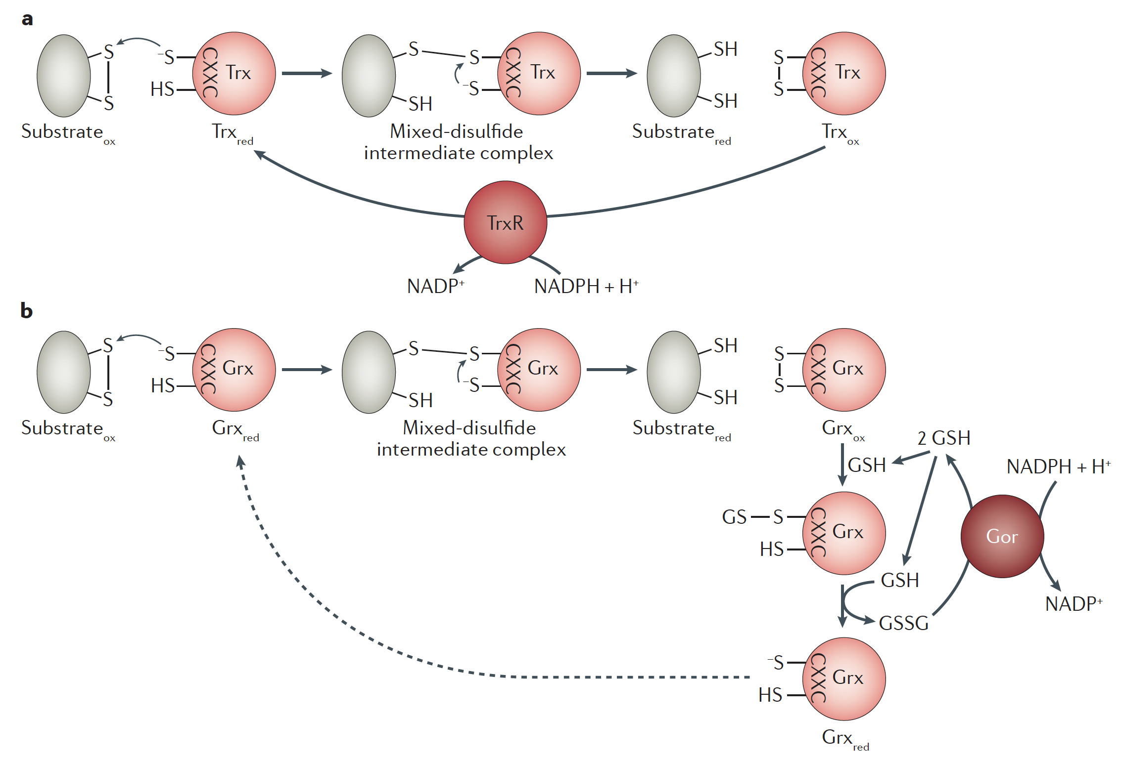
Repairs of Cysteine and Methionine in the Cytoplasm
Thioredoxin (Trxs)
Glutaredoxin (Grxs)
NADPH needs to be replenished for ROS defense
Ezraty et al. 2017. Nat. Rev. Microbiol.

Slide 5
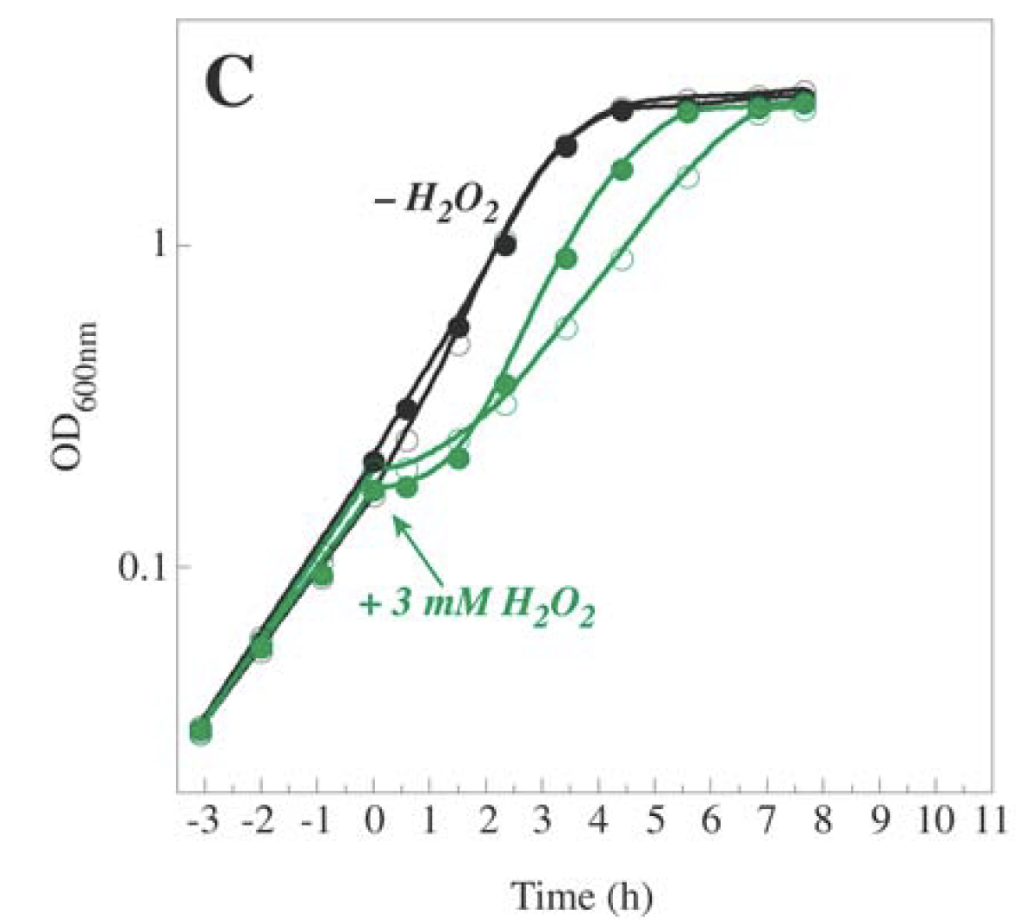
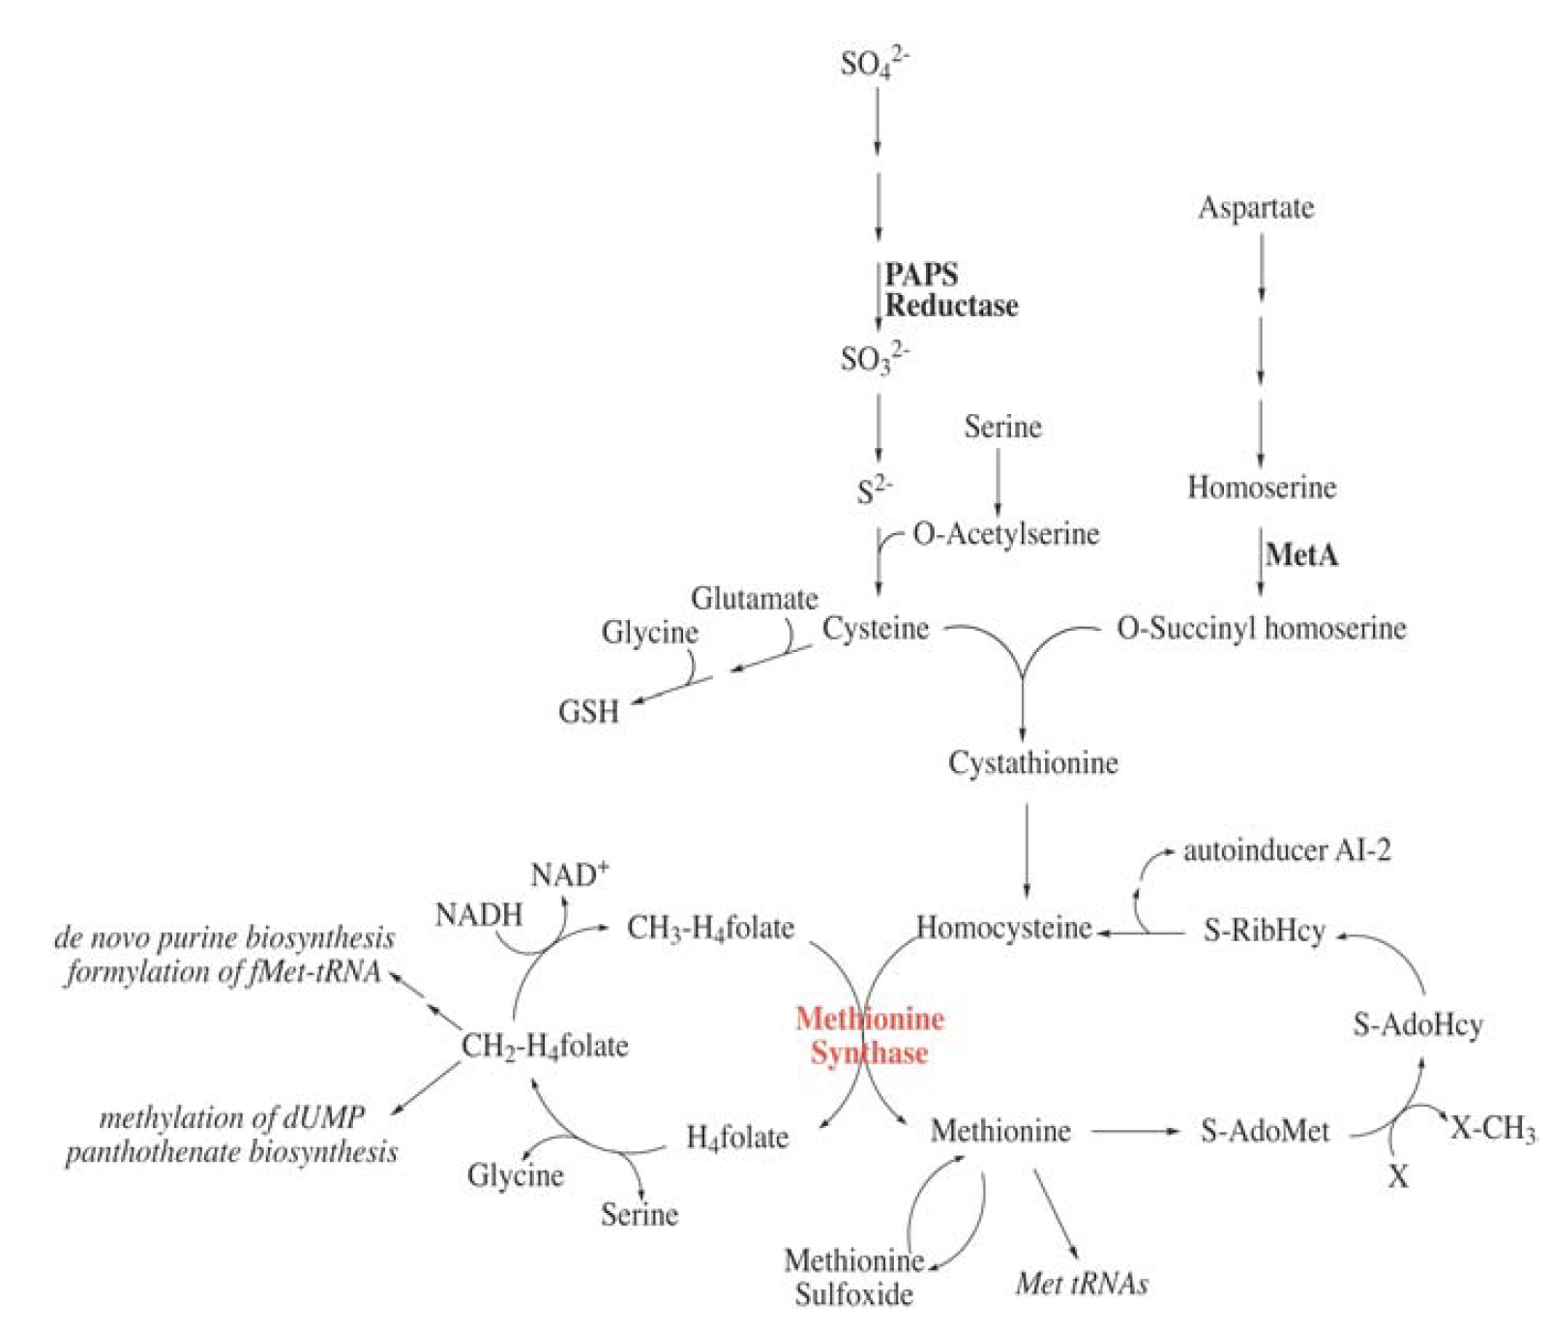
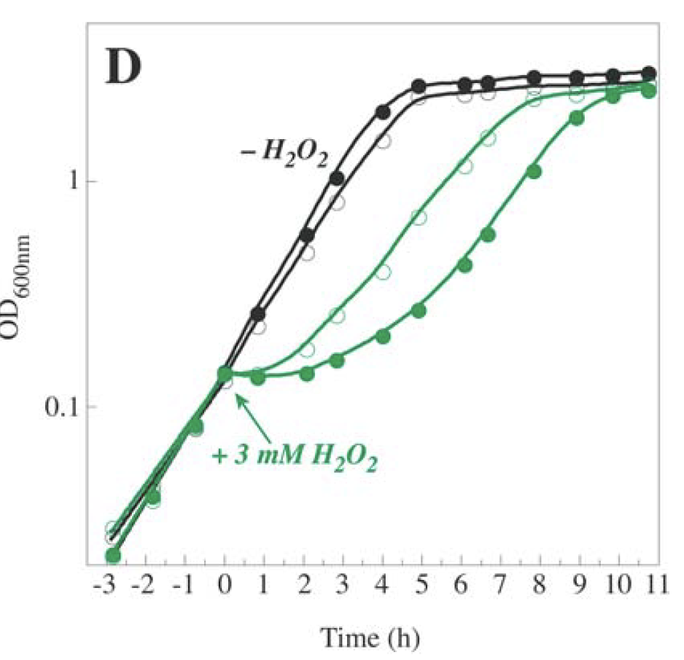
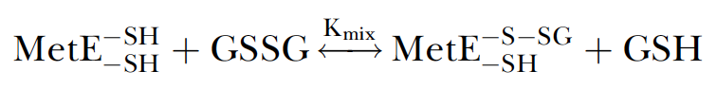
Hydrogen Peroxide Inactivates MetE and Leads to Met Limitation in Minimal Medium
Hondorp et al. 2004. PLoS Biol.
Filled: + Met
Empty: no Met
Filled: + homocysteine
Empty: no homocysteine

Slide 6
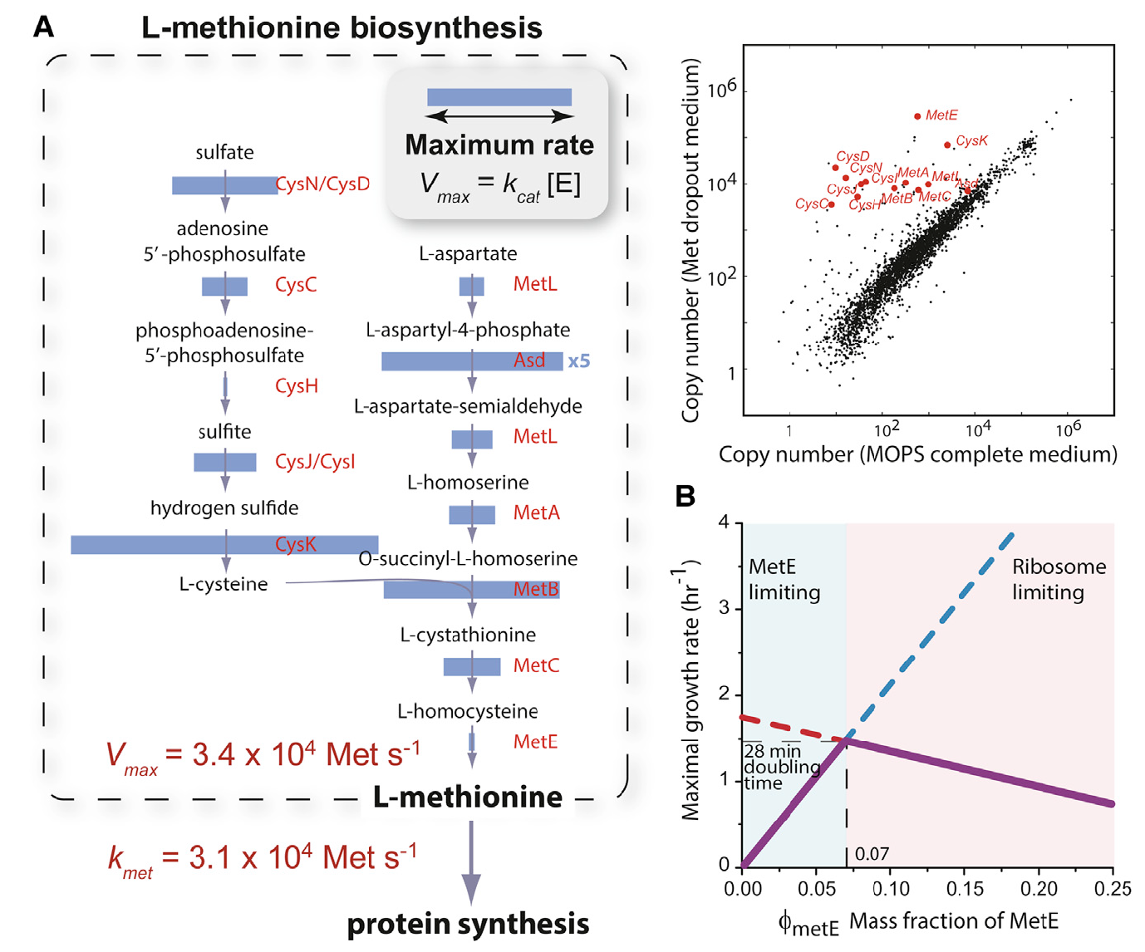
Met Biosynthesis by MetE is the Limiting Step in Protein Synthesis
MetE ~ 7% of total protein in MOPS w/o Met
Li et al. 2014. Cell

Slide 7
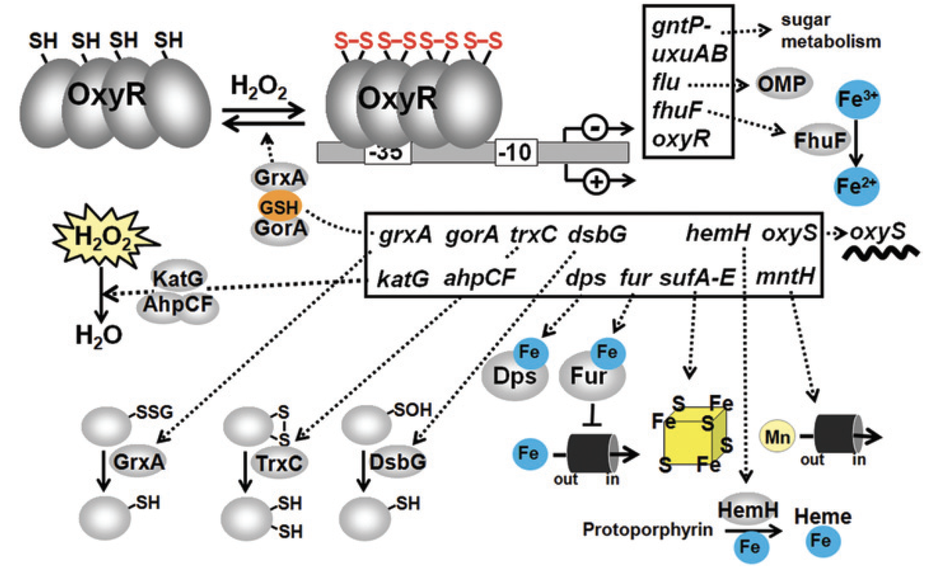
OxyR-mediated Hydrogen Peroxide Sensing and Signaling
Glutaredoxin 1
Thioredoxin 2
Hillion and Antelmann. 2015. Biol. Chem.
Notes:
OxyR positively controls genes for peroxide detoxification, such as catalase and peroxiredoxin (katG, ahpCF), Fe-storage miniferritin (dps), glutaredoxin, thioredoxin and glutathione reductase (grxA, trxC, gor), sulfenic acid oxidoreductase (dsbG), ferric uptake regulator (fur), Fe-S-cluster assembly machinery (sufABCDE), ferrochelatase (hemH), manganes import (mntH) and the small RNA (oxyS).
OxyR negatively regulates its own expression and that of the genes for the ferric ion reductase (fhuF), the outer membrane protein (flu), the mannonate hydrolase (uxuAB) and gluconate permease (gntP).

Slide 8
Integrative Modeling of H2O2 Stress Response Network
Dissolved O₂
Glucose
Extracellular H₂O₂
Central Carbon Metabolism
Pentose phosphate pathway
TCA cycle
Respiratory chains
Fermentation pathways
Oxygen sensing and regulation (Fnr and ArcA/B)
NADPH
OxyR oxidation/reduction
Gene expression of ROS defense systems
H₂O₂ degradation reactions
GSH/GSSG balance
O₂ uptake rate
Intracellular H2O2
Methionine biosynthesis
Ribosome biosynthesis
MetE biosynthesis
Methionine oxidation
MetE glutathionylation
Cell Growth
ATP production rate
GSH/GSSG
Key assumption: met biosynthesis rate is proportional to ATP production rate
Growth rate

Slide 9
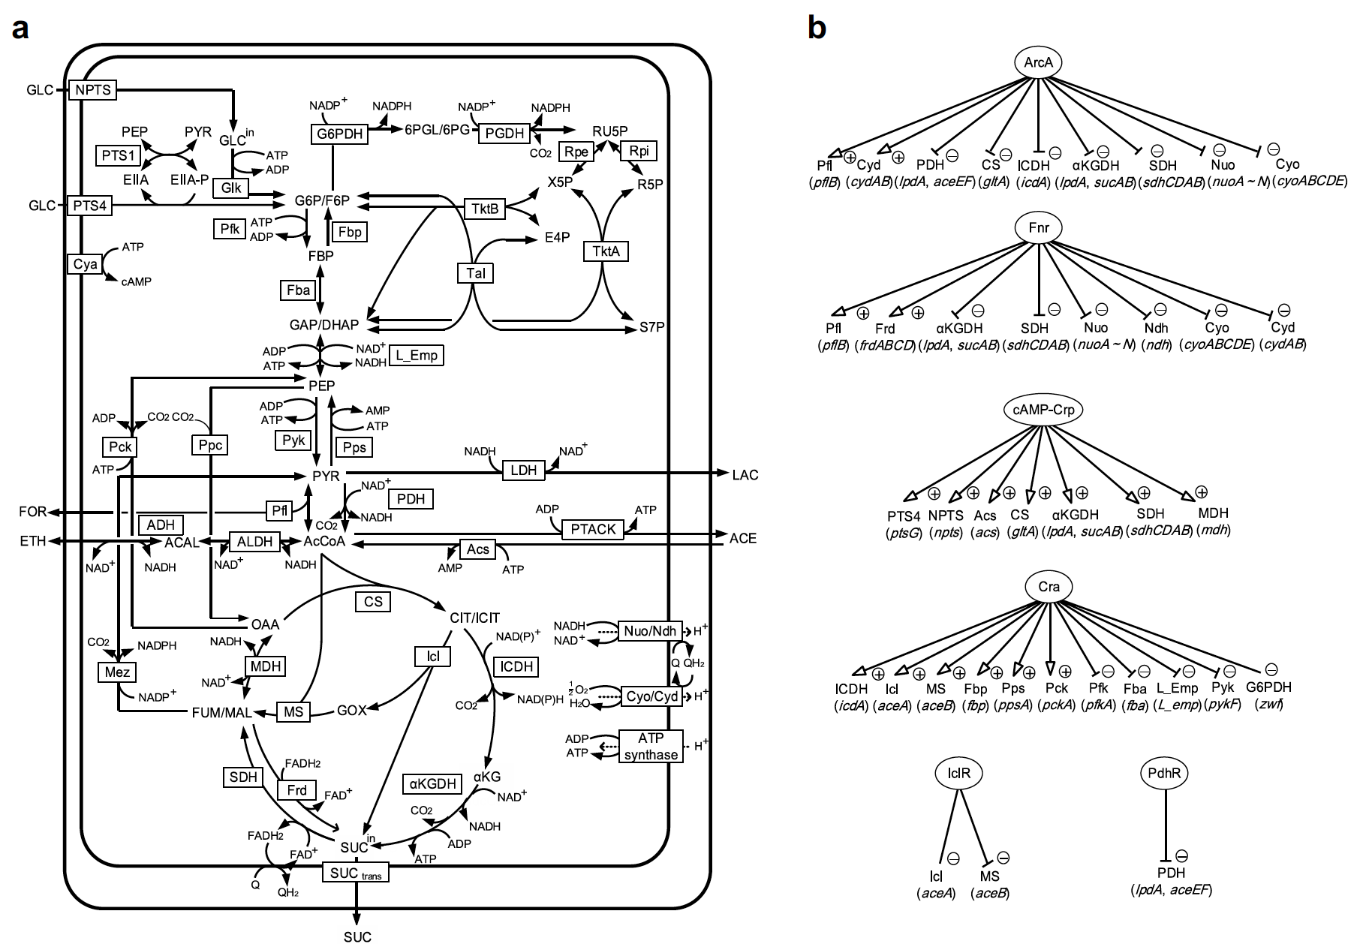
Module 1: Redox Regulation of Central Carbon Metabolism at Different Dissolved Oxygen Concentration
Matsuoka and Kurata. 2017. Biotechnol. Biofuel

Slide 10
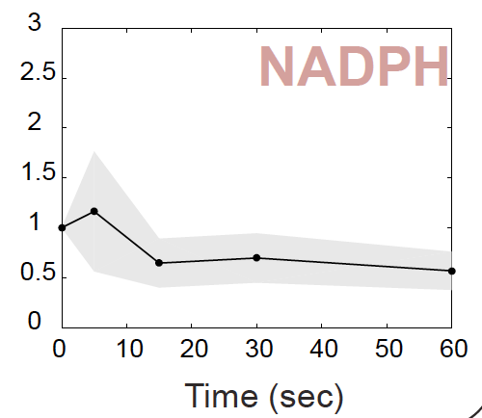
Module 1: NADPH Depletion upon 1 mM H2O2 Stress
Which of the two systems (or both) is responsible for the NADPH depletion?

Slide 11
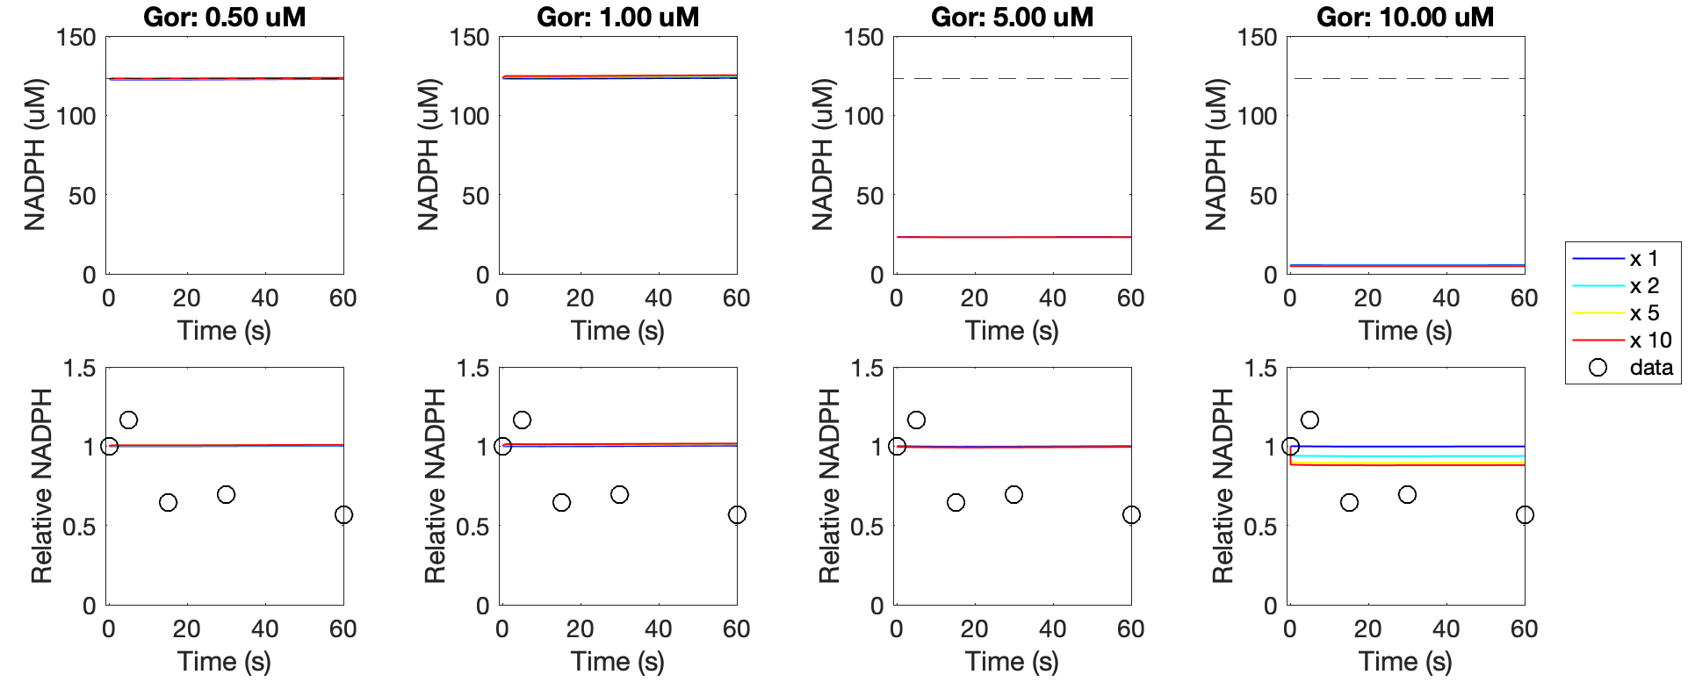
Module 1: NADPH consumption by GSH/Grx/GR System
Reaction rates obtained from E. coli CCM model
K_{drain} is tuned such that NADPH is 123 uM at time 0
GSSG is 2.37 mM (concentration w/o H2O2) multiplied by various fold changes (1, 2, 5, 10). Maximum fold change: (8.3+2.37)/2.37 = 4.5
Gor concentration is 2.85/1.2 uM. So we try 0.5 – 10 uM.
123 uM

Slide 12
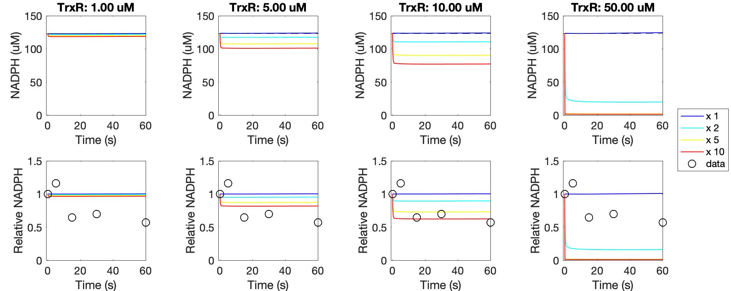
Module 1: NADPH Consumption by Trx/TrxR System
Reaction rates obtained from E. coli CCM model
K_{drain} is tuned such that NADPH is 123 uM at time 0
Trx_{ox} is 1.2 uM (assuming redox potential -280 mV) multiplied by various fold changes (1, 2, 5, 10). Maximum fold change: (8.8+1.2)/1.2 = 8.33
TrxR concentration is 8 uM. So we try 1 – 50 uM.
123 uM

Slide 13
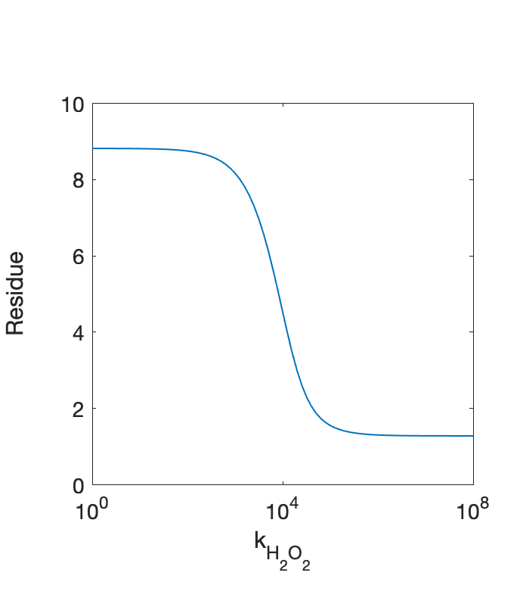
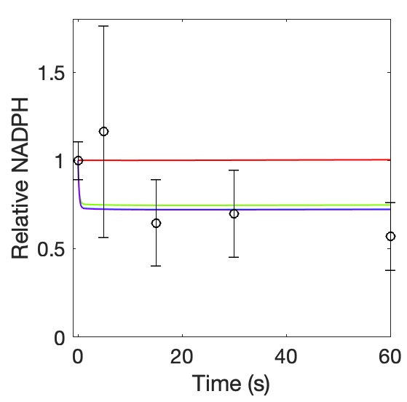
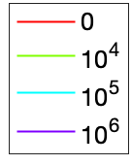
Module 1: Modeling Thioredoxin Oxidation/Reduction
Specific reactions
Generic reaction to account for all other H₂O₂-mediated oxidation of thioredoxin
TrxR = 8 uM

Slide 14
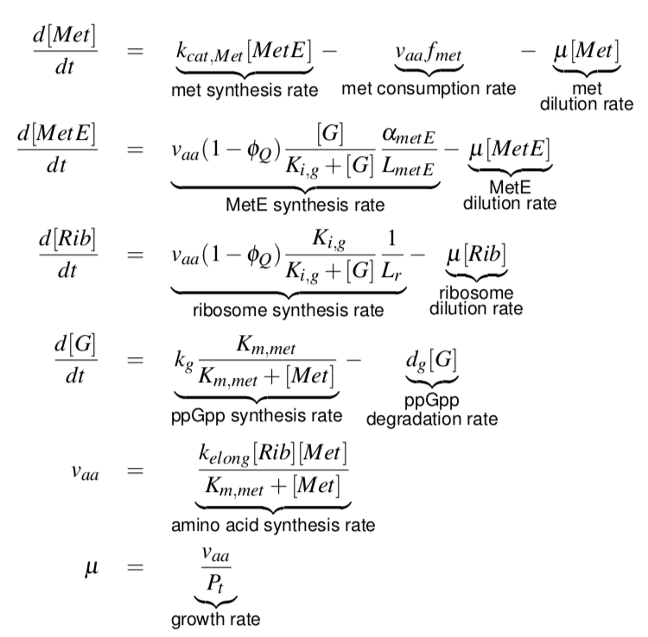
Module 2: Methionine Biosynthesis and Cell Growth
Oxidation and reduction of Met and MetE are not modelled

Slide 15
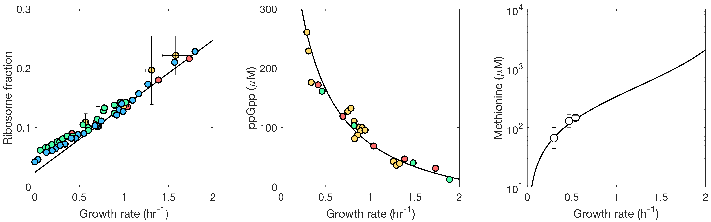
Module 2: Model Validation

Slide 16
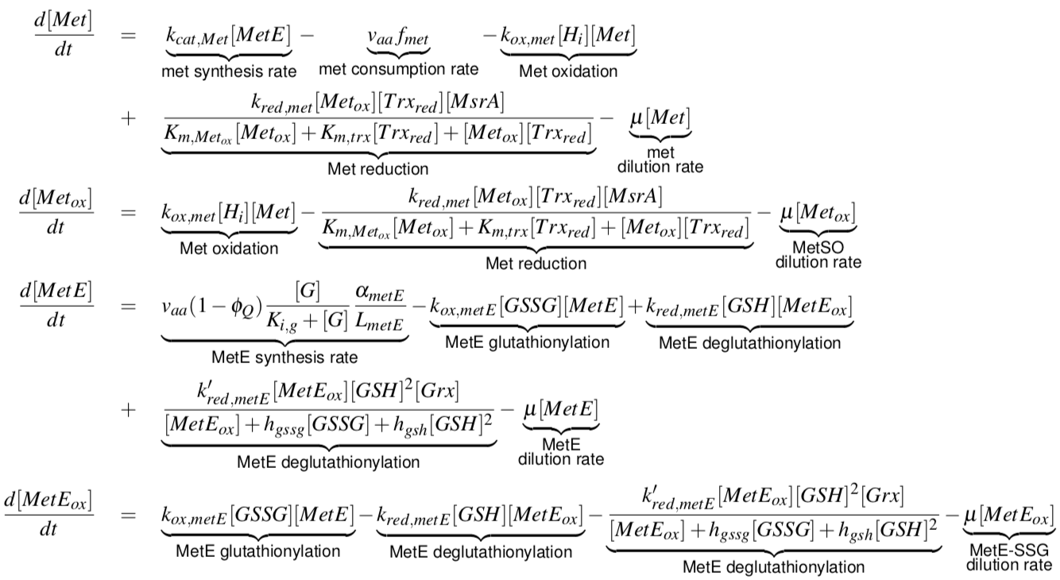
Module 2: Met and MetE oxidation/reduction
Adolfen et al. 2015. PLoS Comput. Biol.
Adolfen et al. 2015. PLoS Comput. Biol.
Hondorp et al. 2004. PLoS Biol.
This work

Slide 17
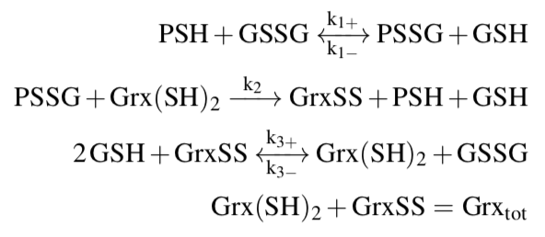
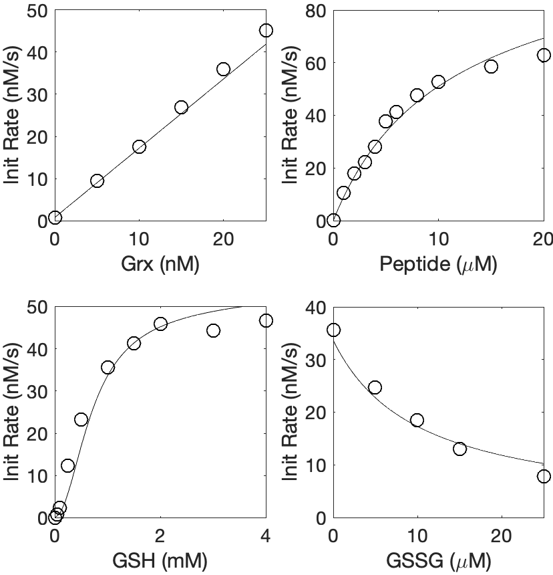
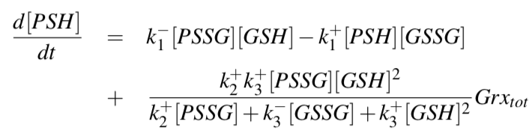
Module 2: Validation of S-glutathionylation Model
Kinetic model of S-glutathionylation
Validation using synthetic peptide data

Slide 18
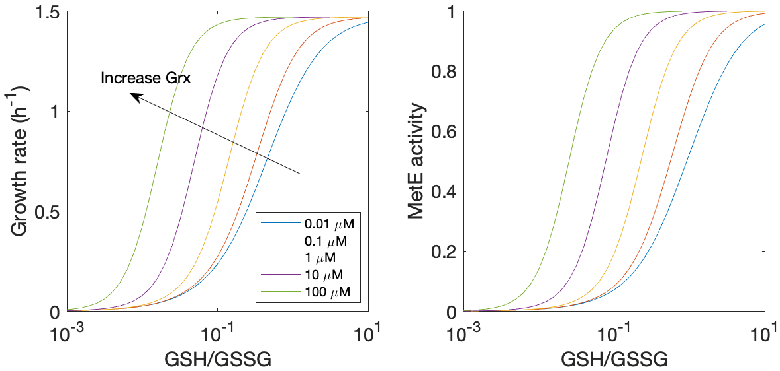
Module 2: Growth inhibition due to Oxidation of MetE
The ratio GSH/GSSG is often used as a measure of oxidative stress
Notes:
GSH=5mM

Slide 19
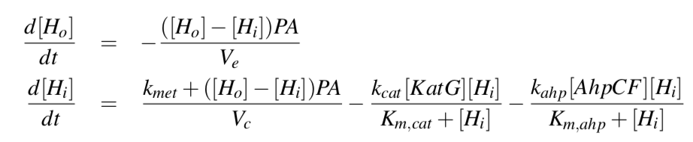
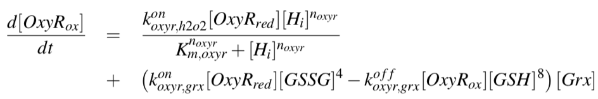
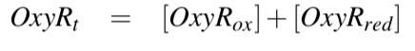
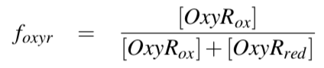
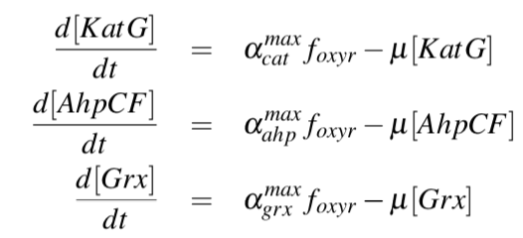
Module 3: OxyR-dependent H2O2 Sensing and Regulation

Slide 20
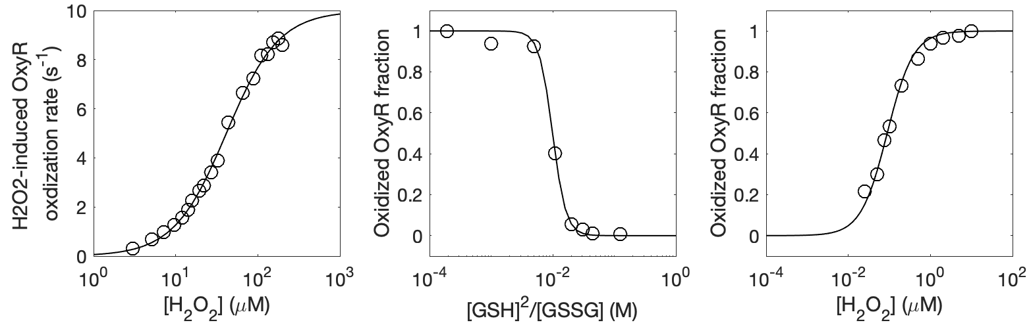
Module 3: Validation of OxyR activation using In Vitro Data
GSSG = 0.1 mM
GSH = 25 mM
Grx = 10 uM

Slide 21
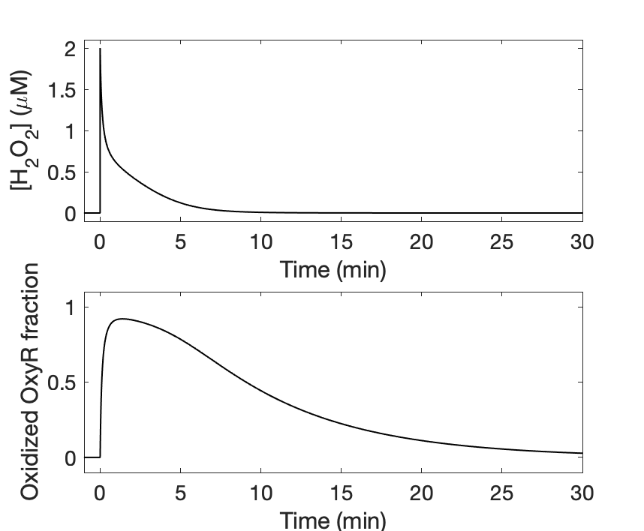
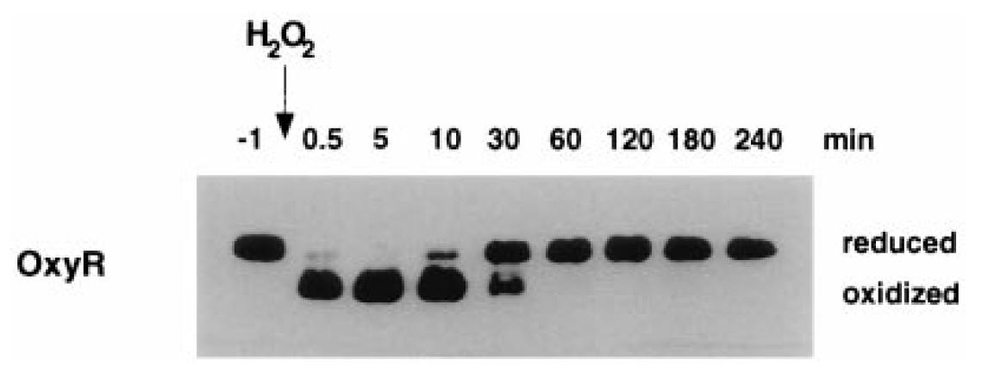
Module 3: Transient OxyR activation by H2O2 In Vitro

Slide 22
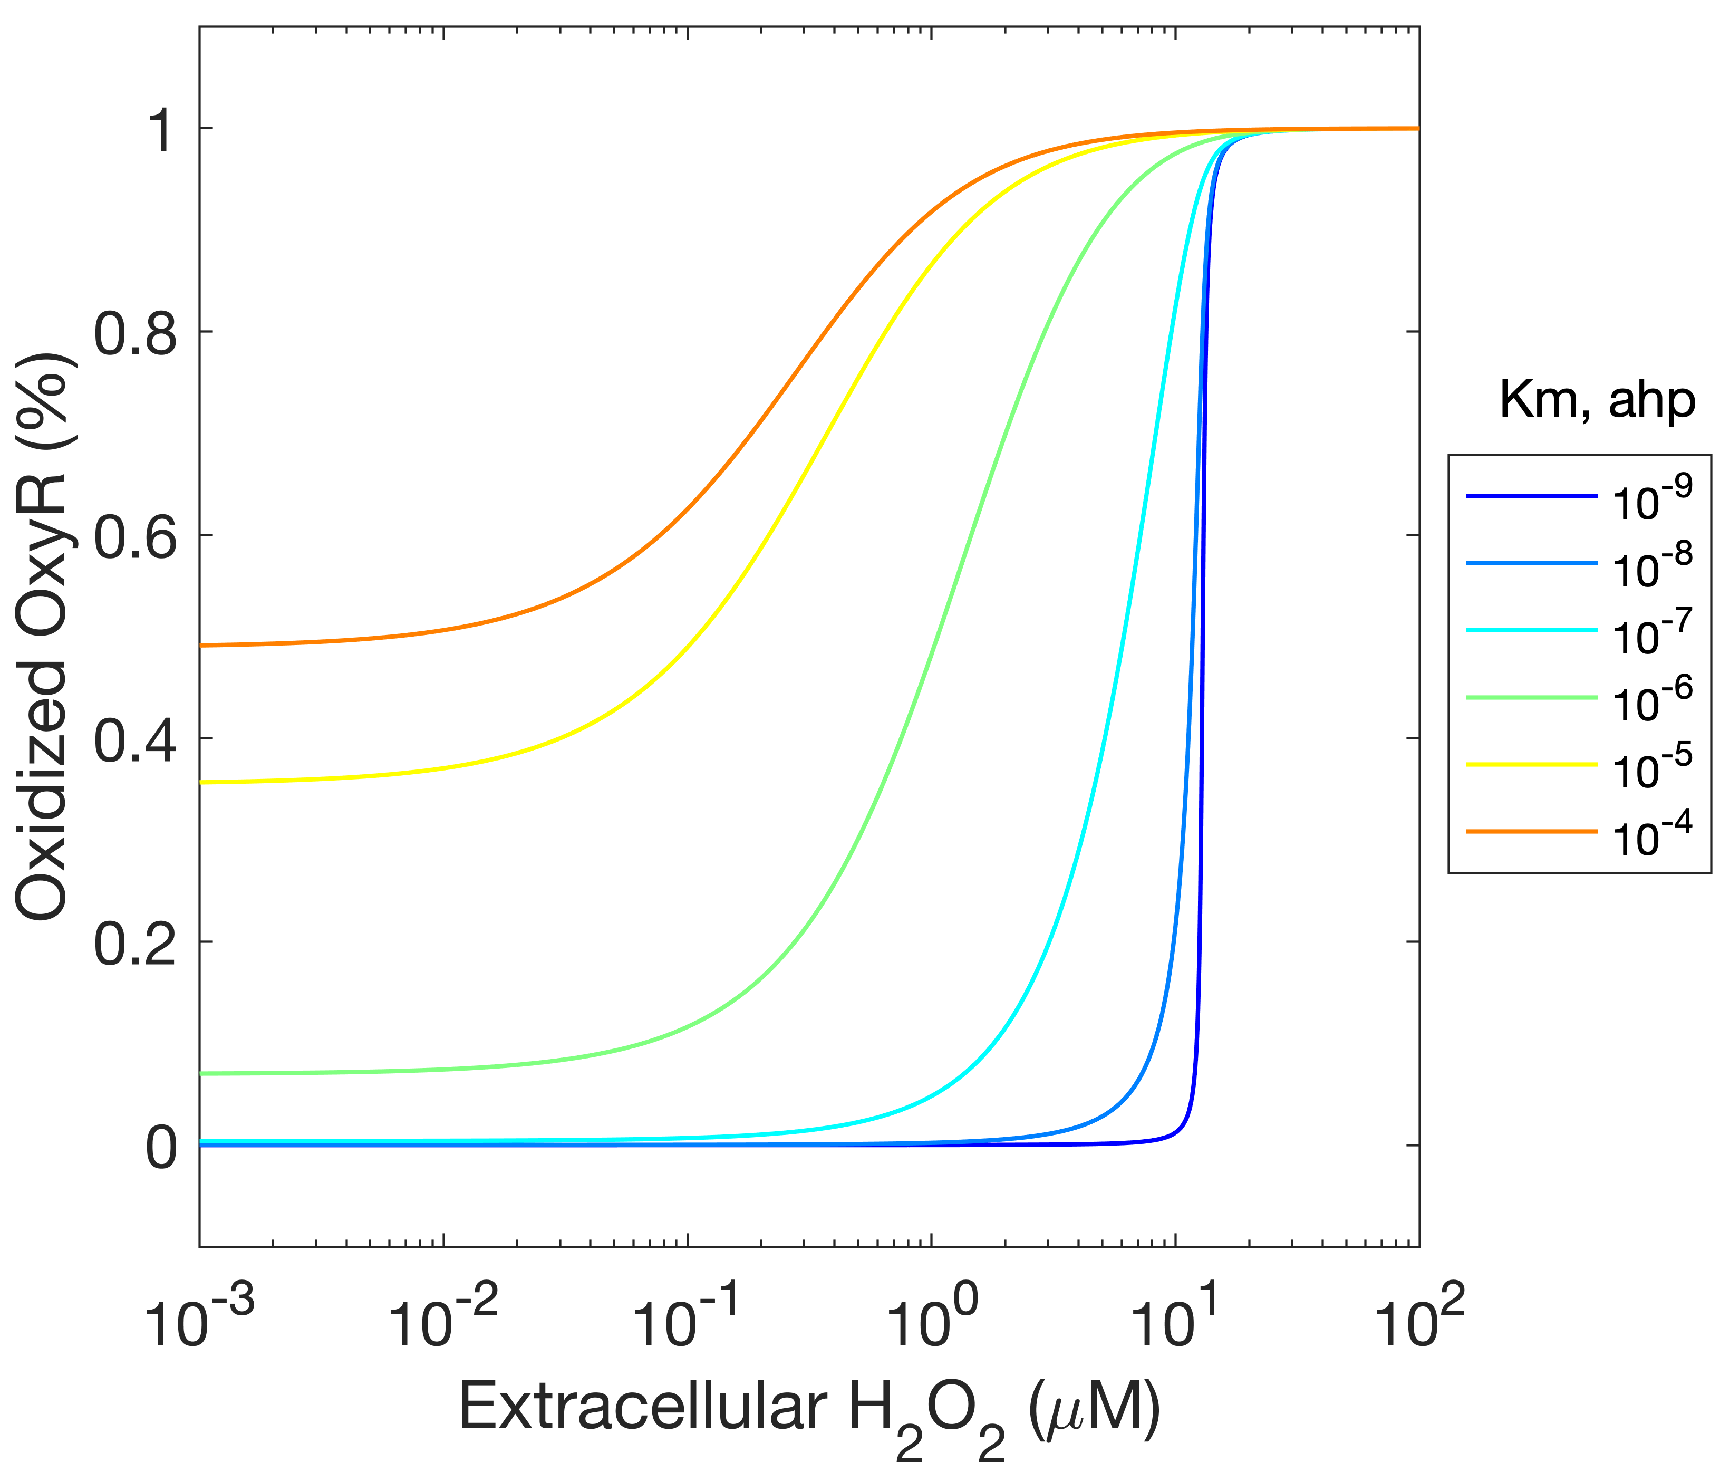
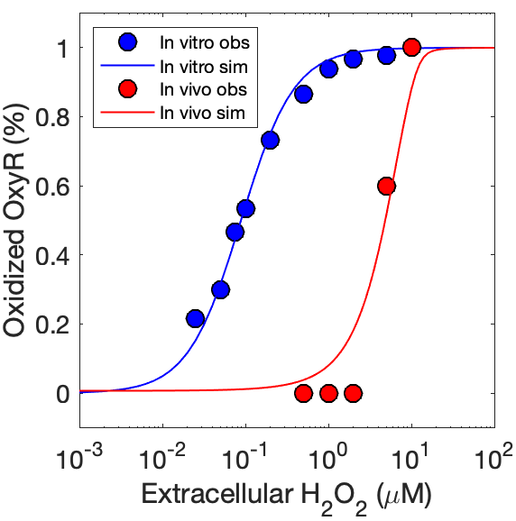
Module 3: Ultrasensitive OxyR activation by H2O2 In Vivo
By tuning Michaelis constant of AhpCF-mediated H2O2 degradation, we are able to tune sensitivity of OxyR oxidation to extracellular H2O2 stress

Slide 23
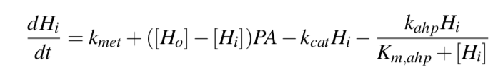
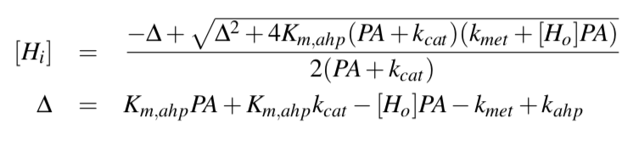
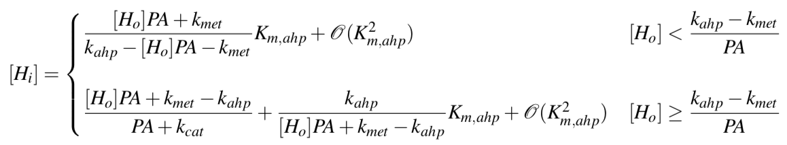
Module 3: Zero-order Ultrasensitivity near Saturation of AhpCF
Simplified model:
Steady state solution:
First-order approximation:
Intracellular H2O2 increases abruptly when extracellular H2O2 exceeds a threshold

Slide 24
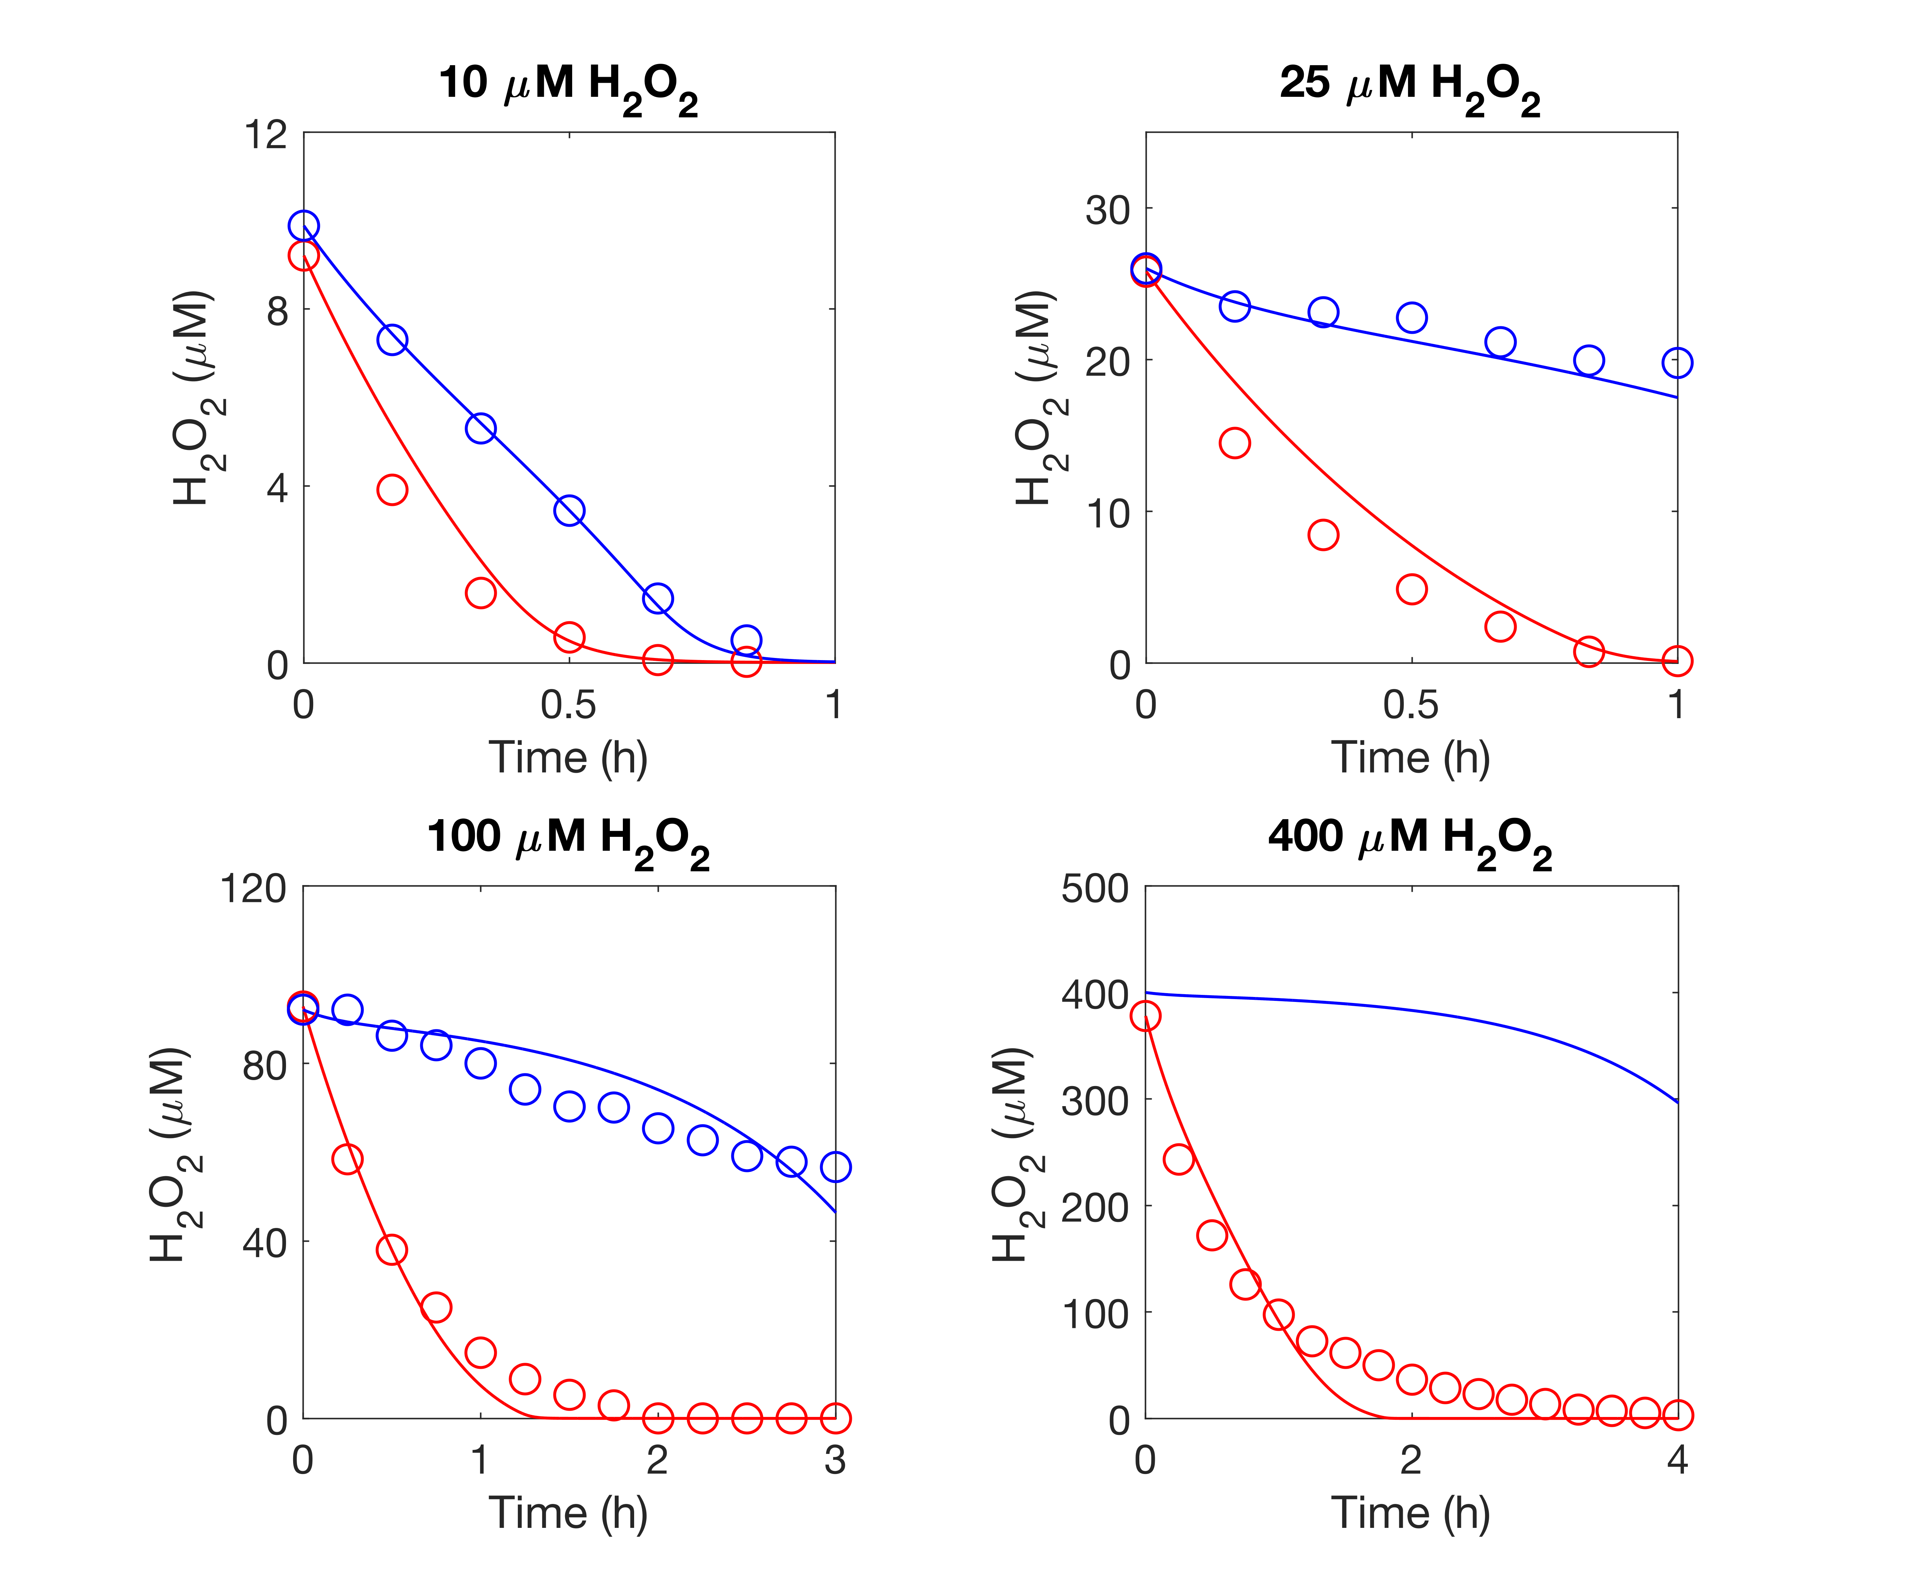
Module 3: Validation using Extracellular H2O2 Clearance data
Red: WT
Blue: KatG mutant

Slide 25
Integrative Model: Validation using Transient Growth rate Changes upon H2O2 challenge

Slide 26
Integrative Model: Computational Predictions
How does H2O2 detoxification depend on cell density? Defend by colony vs. defend by individual?
Can Kat+ cells crossprotect Kat- cells and how does protective effect depend on initial ratios?
Cost (oxidative stress) and benefit (energy production) of using oxygen.

